Slide 1
Project planning

Slide 2
PROJECT PLANNING
Software pricing
Plan-driven development
Project scheduling
Agile planning
Estimation techniques

Slide 3
Project planning
Project planning involves breaking down the work into parts and assign these to project team members, anticipate problems that might arise and prepare tentative solutions to those problems.
The project plan, which is created at the start of a project, is used to communicate how the work will be done to the project team and customers, and to help assess progress on the project.

Slide 4
Planning stages
At the proposal stage, when you are bidding for a contract to develop or provide a software system.
During the project startup phase, when you have to plan who will work on the project, how the project will be broken down into increments, how resources will be allocated across your company, etc.
Periodically throughout the project, when you modify your plan in the light of experience gained and information from monitoring the progress of the work.

Slide 5
Proposal planning
Planning may be necessary with only outline software requirements.
The aim of planning at this stage is to provide information that will be used in setting a price for the system to customers.

Slide 6
Software pricing
Estimates are made to discover the cost, to the developer, of producing a software system.
You take into account, hardware, software, travel, training and effort costs.
There is not a simple relationship between the development cost and the price charged to the customer.
Broader organisational, economic, political and business considerations influence the price charged.

Slide 7
Factors affecting software pricing
Factor | Description
Market opportunity | A development organization may quote a low price because it wishes to move into a new segment of the software market. Accepting a low profit on one project may give the organization the opportunity to make a greater profit later. The experience gained may also help it develop new products.
Cost estimate uncertainty | If an organization is unsure of its cost estimate, it may increase its price by a contingency over and above its normal profit.
Contractual terms | A customer may be willing to allow the developer to retain ownership of the source code and reuse it in other projects. The price charged may then be less than if the software source code is handed over to the customer.

Slide 8
Factors affecting software pricing
Factor | Description
Requirements volatility | If the requirements are likely to change, an organization may lower its price to win a contract. After the contract is awarded, high prices can be charged for changes to the requirements.
Financial health | Developers in financial difficulty may lower their price to gain a contract. It is better to make a smaller than normal profit or break even than to go out of business. Cash flow is more important than profit in difficult economic times.

Slide 9
Plan-driven development
Plan-driven or plan-based development is an approach to software engineering where the development process is planned in detail.
Plan-driven development is based on engineering project management techniques and is the ‘traditional’ way of managing large software development projects.
A project plan is created that records the work to be done, who will do it, the development schedule and the work products.
Managers use the plan to support project decision making and as a way of measuring progress.

Slide 10
Plan-driven development – pros and cons
The arguments in favor of a plan-driven approach are that early planning allows organizational issues (availability of staff, other projects, etc.) to be closely taken into account, and that potential problems and dependencies are discovered before the project starts, rather than once the project is underway.
The principal argument against plan-driven development is that many early decisions have to be revised because of changes to the environment in which the software is to be developed and used.

Slide 11
Project plans
In a plan-driven development project, a project plan sets out the resources available to the project, the work breakdown and a schedule for carrying out the work.
Plan sections
Introduction
Project organization
Risk analysis
Hardware and software resource requirements
Work breakdown
Project schedule
Monitoring and reporting mechanisms

Slide 12
Project plan supplements
Plan | Description
Quality plan | Describes the quality procedures and standards that will be used in a project.
Validation plan | Describes the approach, resources, and schedule used for system validation.
Configuration management plan | Describes the configuration management procedures and structures to be used.
Maintenance plan | Predicts the maintenance requirements, costs, and effort.
Staff development plan | Describes how the skills and experience of the project team members will be developed.

Slide 13
The planning process
Project planning is an iterative process that starts when you create an initial project plan during the project startup phase.
Plan changes are inevitable.
As more information about the system and the project team becomes available during the project, you should regularly revise the plan to reflect requirements, schedule and risk changes.
Changing business goals also leads to changes in project plans. As business goals change, this could affect all projects, which may then have to be re-planned.

Slide 14
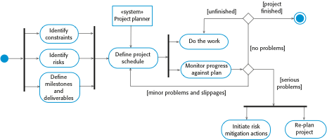
The project planning process

Slide 15
Project scheduling
Project scheduling is the process of deciding how the work in a project will be organized as separate tasks, and when and how these tasks will be executed.
You estimate the calendar time needed to complete each task, the effort required and who will work on the tasks that have been identified.
You also have to estimate the resources needed to complete each task, such as the disk space required on a server, the time required on specialized hardware, such as a simulator, and what the travel budget will be.

Slide 16
Project scheduling activities
Split project into tasks and estimate time and resources required to complete each task.
Organize tasks concurrently to make optimal use of workforce.
Minimize task dependencies to avoid delays caused by one task waiting for another to complete.
Dependent on project managers intuition and experience.

Slide 17
Milestones and deliverables
Milestones are points in the schedule against which you can assess progress, for example, the handover of the system for testing.
Deliverables are work products that are delivered to the customer, e.g. a requirements document for the system.

Slide 18

The project scheduling process

Slide 19
Scheduling problems
Estimating the difficulty of problems and hence the cost of developing a solution is hard.
Productivity is not proportional to the number of people working on a task.
Adding people to a late project makes it later because of communication overheads.
The unexpected always happens. Always allow contingency in planning.

Slide 20
Schedule representation
Graphical notations are normally used to illustrate the project schedule.
These show the project breakdown into tasks. Tasks should not be too small. They should take about a week or two.
Bar charts are the most commonly used representation for project schedules. They show the schedule as activities or resources against time.

Slide 21
Tasks, durations, and dependencies
Task | Effort (person-days) | Duration (days) | Dependencies
T1 | 15 | 10
T2 | 8 | 15
T3 | 20 | 15 | T1 (M1)
T4 | 5 | 10
T5 | 5 | 10 | T2, T4 (M3)
T6 | 10 | 5 | T1, T2 (M4)
T7 | 25 | 20 | T1 (M1)
T8 | 75 | 25 | T4 (M2)
T9 | 10 | 15 | T3, T6 (M5)
T10 | 20 | 15 | T7, T8 (M6)
T11 | 10 | 10 | T9 (M7)
T12 | 20 | 10 | T10, T11 (M8)

Slide 22
A Man-day or Person-day Simply means 8 hours of work for 1 person.
1) Estimate how long it will take to perform each task
2) Add them up
3) divide by 8= Man-days or Person-days

Slide 23
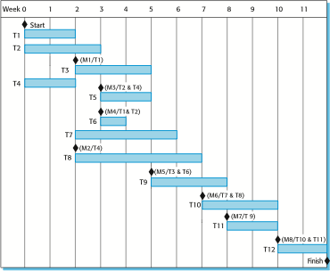
Activity bar chart

Slide 24
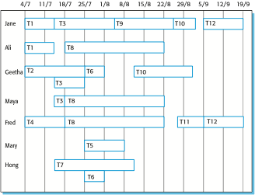
Staff allocation chart

Slide 25
Agile planning
Agile methods of software development are iterative approaches where the software is developed and delivered to customers in increments.
Unlike plan-driven approaches, the functionality of these increments is not planned in advance but is decided during the development.
The decision on what to include in an increment depends on progress and on the customer’s priorities.
The customer’s priorities and requirements change so it makes sense to have a flexible plan that can accommodate these changes.

Slide 26
Agile planning stages
Release planning, which looks ahead for several months and decides on the features that should be included in a release of a system.
Iteration planning, which has a shorter term outlook, and focuses on planning the next increment of a system. This is typically 2-4 weeks of work for the team.

Slide 27

Planning in XP

Slide 28
Story-based planning
The system specification in XP is based on user stories that reflect the features that should be included in the system.
The project team read and discuss the stories and rank them in order of the amount of time they think it will take to implement the story.
Release planning involves selecting and refining the stories that will reflect the features to be implemented in a release of a system and the order in which the stories should be implemented.
Stories to be implemented in each iteration are chosen, with the number of stories reflecting the time to deliver an iteration (usually 2 or 3 weeks).

Slide 29
Estimation techniques
Organizations need to make software effort and cost estimates. There are two types of technique that can be used to do this:
Experience-based techniques The estimate of future effort requirements is based on the manager’s experience of past projects and the application domain. Essentially, the manager makes an informed judgment of what the effort requirements are likely to be.
Algorithmic cost modeling In this approach, a formulaic approach is used to compute the project effort based on estimates of product attributes, such as size, and process characteristics, such as experience of staff involved.

Slide 30
Experience-based approaches
Experience-based techniques rely on judgments based on experience of past projects and the effort expended in these projects on software development activities.
Typically, you identify the deliverables to be produced in a project and the different software components or systems that are to be developed.
You document these in a spreadsheet, estimate them individually and compute the total effort required.
It usually helps to get a group of people involved in the effort estimation and to ask each member of the group to explain their estimate.

Slide 31
Algorithmic cost modelling
Cost is estimated as a mathematical function of product, project and process attributes whose values are estimated by project managers:
Effort = A ×Size^{B}×M
A is an organisation-dependent constant, B reflects the disproportionate effort for large projects and M is a multiplier reflecting product, process and people attributes.
SIZE may be code size or function points
B usually lies between 1 to 1.5
The most commonly used product attribute for cost estimation is code size.
Most models are similar but they use different values for A, B and M.

Slide 32
Estimation accuracy
The size of a software system can only be known accurately when it is finished.
Several factors influence the final size
Use of COTS and components;
Programming language;
Distribution of system.
As the development process progresses then the size estimate becomes more accurate.
The estimates of the factors contributing to B and M are subjective and vary according to the judgment of the estimator.

Slide 33
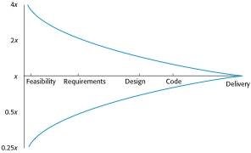
Estimate uncertainty

Slide 34
Estimation techniques
Organizations need to make software effort and cost estimates. There are two types of technique that can be used to do this:
Experience-based techniques The estimate of future effort requirements is based on the manager’s experience of past projects and the application domain. Essentially, the manager makes an informed judgment of what the effort requirements are likely to be.
Algorithmic cost modeling In this approach, a formulaic approach is used to compute the project effort based on estimates of product attributes, such as size, and process characteristics, such as experience of staff involved.

Slide 35
Experience-based approaches
Experience-based techniques rely on judgments based on experience of past projects and the effort expended in these projects on software development activities.
Typically, you identify the deliverables to be produced in a project and the different software components or systems that are to be developed.
You document these in a spreadsheet, estimate them individually and compute the total effort required.
It usually helps to get a group of people involved in the effort estimation and to ask each member of the group to explain their estimate.

Slide 36
Algorithmic cost modelling
Cost is estimated as a mathematical function of product, project and process attributes whose values are estimated by project managers:
Effort = A ×Size^{B}×M
A is an organisation-dependent constant, B reflects the disproportionate effort for large projects and M is a multiplier reflecting product, process and people attributes.
The most commonly used product attribute for cost estimation is code size.
Most models are similar but they use different values for A, B and M.

Slide 37
Estimation accuracy
The size of a software system can only be known accurately when it is finished.
Several factors influence the final size
Use of COTS and components;
Programming language;
Distribution of system.
As the development process progresses then the size estimate becomes more accurate.
The estimates of the factors contributing to B and M are subjective and vary according to the judgment of the estimator.

Slide 38
Estimate uncertainty

Slide 39
The COCOMO 2 model
An empirical model based on project experience.
Well-documented, ‘independent’ model which is not tied to a specific software vendor.
Long history from initial version published in 1981 (COCOMO-81) through various instantiations to COCOMO 2.
COCOMO 2 takes into account different approaches to software development, reuse, etc.

Slide 40
COCOMO 2 models
COCOMO 2 incorporates a range of sub-models that produce increasingly detailed software estimates.
The sub-models in COCOMO 2 are:
Application composition model. Used when software is composed from existing parts.
Early design model. Used when requirements are available but design has not yet started.
Reuse model. Used to compute the effort of integrating reusable components.
Post-architecture model. Used once the system architecture has been designed and more information about the system is available.

Slide 41
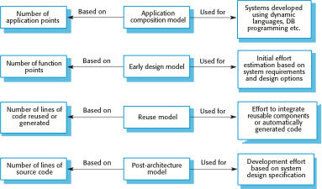
COCOMO estimation models

Slide 42
Project duration and staffing
As well as effort estimation, managers must estimate the calendar time required to complete a project and when staff will be required.
Calendar time can be estimated using a COCOMO 2 formula
TDEV = 3 × (PM)^{(0.33+0.2*(B-1.01))}
PM is the effort computation and B is the exponent computed as discussed above (B is 1 for the early prototyping model). This computation predicts the nominal schedule for the project.
The time required is independent of the number of people working on the project.

Slide 43
Staffing requirements
Staff required can’t be computed by diving the development time by the required schedule.
The number of people working on a project varies depending on the phase of the project.
The more people who work on the project, the more total effort is usually required.
A very rapid build-up of people often correlates with schedule slippage.

